Slide 1
Co-occurring Substance Use and MOUD
CA Hub and Spoke Learning Collaborative, Q6
March 2019

Slide 2
Agenda
Welcome and Introductions
Addressing co-occurring substance use in patients on MOUD
Group activity
Presentation
Solutions and summary
QI reports
Next steps and wrap up

Slide 3
Comorbid Substance Use and MOUD

Slide 4
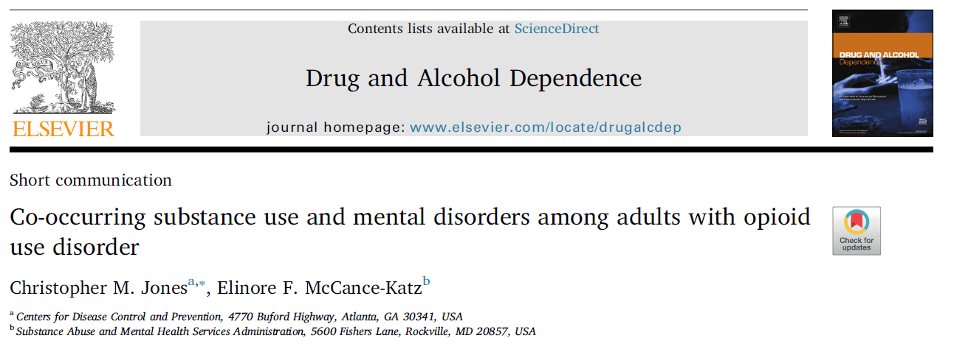
Drug and Alcohol Dependence Excerpt

Slide 5
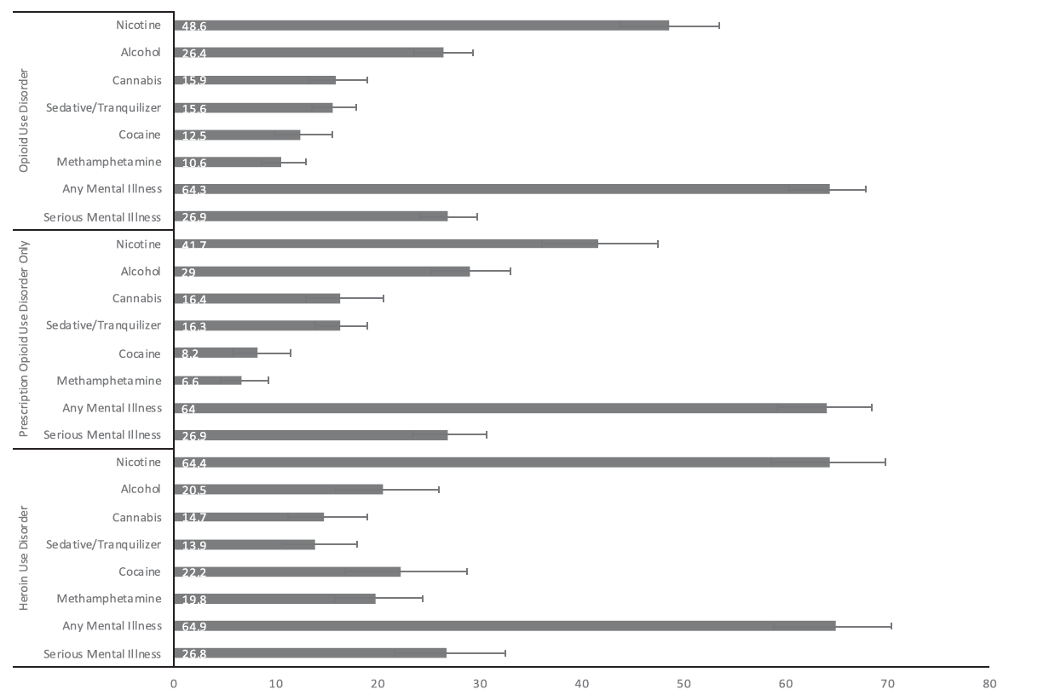
Co-occurring mental illness

Slide 6
Background
Co-occurring substance use in patients on MOUD is very common
Nearly one third of people in SUD treatment in 2013 reported treatment for alcohol AND other drugs
OUD is typically the most severe of comorbid conditions and should be priority of treatment

Slide 7
Stimulants

Slide 8
Methamphetamine use among patients with chronic opioid use is on the rise
Ellis, MS, Kasper, ZA, Cicero, TJ (2018). Twin epidemics: The surging rise of methamphetamine use in chronic opioid users. Drug and Alcohol Dependence, v193, 1 Dec 2018, 14-20.
Notes:
Fig. 1. The percent of SKIP respondents (N = 13,521) who endorsed past month use of methamphetamine by year from 2011, quarters 2–4, to 2017, quarter 1.

Slide 9
Gender vs Race vs Urbanicity vs Regionality
Notes:
Tables show stimulant use by demographic. Note in the lower right corner, the West is indicated by the red line, demonstrating the largest increase in meth use in the Western region. Rising in all regions, but most in the West

Slide 10
Clinical Challenges Individuals Using Stimulants
Limited understanding of stimulant use disorder
Ambivalence about need to stop use
Cognitive impairment and poor memory
Short attention span
Anhedonia
Powerful Pavlovian trigger-craving response
Sleep disorders
Poor retention in outpatient treatment
Elevated rates of psychiatric co-morbidity
Notes:
Ask participants: What are some of the challenges you’ve had working with individuals using stimulants who are on medicines for OUD?
Discussion of dopamine system. From baseline, food increases DA output over 100%; sex increases output over 200%; amphetamine increases output over 1000%.

Slide 11
What Does Not Work
Confrontation
Insight-oriented psychotherapy
Generic CBT
Intensive group treatment
Kicking people out of treatment

Slide 12
What Does Work
Motivational incentives/Contingency management
Focused CBT
Motivational Interviewing
Medications – off-label effectiveness of buproprion, naltrexone, modafinil, mirtazapine
Early indications that exercise is helpful as well
Notes:
Lara A Ray, Spencer Bujarski, Kelly E Courtney, Nathasha R Moallem, Katy Lunny, Daniel Roche, Adam M Leventhal, Steve Shoptaw, Keith Heinzerling, Edythe D London, Karen Miotto. The Effects of Naltrexone on Subjective Response to Methamphetamine in a Clinical Sample: a Double-Blind, Placebo-Controlled Laboratory Study. Neuropsychopharmacology, 2015; DOI: 10.1038/npp.2015.83

Slide 13
Methamphetamine and Opioid Co-Ingestion – What are the Issues?
A synergistic effect occurs when using meth and an opioid together (i.e., the result of using both is greater than the sum of each)
The stimulant effect counterbalances the depressant effect, thus increasing overdose risk (respiratory depression AND cardiac arrest)
The most potent effect seems to be in the first 90 minutes of co-injection
Notes:
REFERENCES:
Meacham, M.C., Strathdee, S.A., Rangel, G., Armenta, R.F., Gaines, T. L., & Garfein, R.S. (2016). Prevalence and correlates of heroin-methamphetamine co-injection among persons who inject drugs in San Diego, California, and Tijuana, Baja California, Mexico. J. Stud. Alcohol Drugs, 77, 774-781.
Trujillo, K.A., Smith, M.L., & Guaderrama, M.M. (2011). Powerful behavioral interactions between methamphetamine and morphine. Pharmacology, Biochemistry, and Behavior, 99, 451-458.

Slide 14
What are Some Treatment Implications for Methamphetamine and Opioid Co-Ingestion?
Make sure you have sufficient naloxone kits available for overdoses
Combine MOUD for opioids with contingency management (CM) for meth.
Exercise may help to reduce methamphetamine use and reduce depression and anxiety symptoms in meth users
Consider medications with off-label indications
Notes:
Additional question: How to manage patients on MOUD who say the stimulants help their ADHD.

Slide 15
Cannabis

Slide 16
Marijuana is the #1 Illicit Drug Used in the U.S. among People 12 and Older
The number of past month marijuana users corresponds to 8.9% of the US population aged 12 and older
SOURCE: SAMHSA, NSDUH, 2016 findings.
Notes:
NSDUH obtains information on 10 categories of illicit drugs: marijuana, cocaine (including crack), heroin, hallucinogens, inhalants, and methamphetamine, as well as the misuse of prescription pain relievers, tranquilizers, stimulants, and sedatives; see the section on the misuse of psychotherapeutic drugs for the definition of misuse. Estimates of “illicit drug use” reported from NSDUH reflect the data from these 10 drug categories. Because of changes in measurement in 2015 for 7 of the 10 illicit drug categories— hallucinogens, inhalants, methamphetamine, and the misuse of prescription pain relievers, tranquilizers, stimulants, and sedatives—estimates of use of any illicit drug and these 7 illicit drug categories in 2016 are not comparable with estimates prior to 2015.
In 2016, an estimated 28.6 million Americans aged 12 or older were current (past month) illicit drug users, meaning that they had used an illicit drug during the month prior to the survey interview . The most commonly used illicit drug in the past month was marijuana, which was used by 24.0 million people aged 12 or older. An estimated 6.2 million people reported misusing psychotherapeutic drugs at least once in the past month, including 3.3 million people who were misusers of prescription pain relievers. Thus, the number of current misusers of pain relievers was second to marijuana among specific illicit drugs. Smaller numbers of people in 2016 were current users of the other illicit drugs.
The number of current marijuana users was higher in 2016 than it was between 2002 and 2015. The increase in marijuana reflects an increase in use by adults aged 26 and older, and, to a lesser extent, an increase among those age 18-25.
REFERENCE:
NSDUH citation

Slide 17
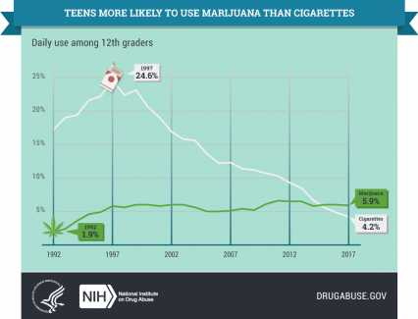
Marijuana is Now More Common than Cigarettes among High School Seniors
24.6%
5.9%
1.9%
4.2%
SOURCE: NIDA, MTF 2017 Results.
Notes:
According to the findings from the 2017 Monitoring the Future Survey, daily marijuana use exceeds daily cigarette use among 8th, 10th, and 12th graders. This year is the first in which daily marijuana use outpaced daily cigarette use. This reflects a steep decline in daily cigarette use and a fairly stable trend in daily marijuana use. The graph included here just includes data for 12th graders.
REFERENCE:
National Institute on Drug Abuse. (2017). Monitoring the Future Survey: High School and Youth Trends. Retrieved from NIDA. (2017, December 14). Monitoring the Future Survey: High School and Youth Trends. Retrieved from https://www.drugabuse.gov/publications/drugfacts/monitoring-future-survey-high-school-youth-trends on 2018, May 16.

Slide 18
Why Do People Use Marijuana?
Among people who used marijuana in the past year:
SOURCE: Pew Charitable Trust, 2013.
Notes:
This chart highlights the findings from a study released in 2013 in which 47% of respondents who used marijuana in the past year reported using it just for fun, 30% reported using it for medical reasons, and 23% reported using it for fun and medical reasons. In other words, over half of the respondents who used marijuana in the past year used it at least in part for medical reasons.
REFERENCE:
Pew Charitable Trust Foundation. (2013). Who’s Used Marijuana and Why?

Slide 19
Acute Effects of Cannabis in Intoxication Phase
Cognition
Difficulty with complex tasks
Difficulty learning
Executive Function
Impaired decision making
Increased risky behavior – STDs, HIV
Mood
Anxiety – panic attacks
Psychosis - paranoia
SOURCE: Dr. Susan Weiss, NIDA, August 2017 National Cannabis Summit Keynote, Denver, CO.

Slide 20
Cannabis Withdrawal
Added to DSM-5 based on research
Irritability, anger, or aggression
Nervousness or anxiety
Sleep difficulty
Decreased appetite/weight loss
Restlessness
Depressed mood/somatic symptoms
Notes:
When people stop using, especially after heavy use, cannabis withdrawal can occur. Symptoms include o cause irritability anger or aggression; nervousness or anxiety; sleep difficulty; decreased appetite/weight loss; restlessness; depressed mood/ somatic symptoms

Slide 21
Is Marijuana Use Associated with an Increased Risk of Opioid Misuse?
Based on data from the National Epidemiologic Survey on Alcohol and Related Conditions
Respondents who reported past-year marijuana use had 2.2 x higher odds than non-users of meeting diagnostic criteria for a prescription opioid use disorder by follow-up
Also had 2.6 x greater odds of initiating prescription opioid misuse
SOURCE: Olfson et al., 2017.
Notes:
Olfson and colleagues analyzed data from the National Epidemiologic Survey on Alcohol and Related Conditions collected in 2001-2002 and 2004-2005. Their analysis focused on individual marijuana users vs. non-users and their trajectories with regard to opioid misuse and disorders. Those respondents who reported past year use of marijuana in their initial interview in 2001-2002 had 2.2 times higher odds than non-users to meet diagnostic criteria for an opioid use disorder at follow-up (2004-2005). They also had a 2.6 times greater odds of initiating prescription drug misuse. The findings are in line with previous research demonstrating that people who use marijuana are more likely than non-users to use other drugs and develop problems with drug use.
A number of recent papers suggest that marijuana may reduce prescription opioid addiction and overdoses by providing an alternative or complementary pain relief option. That suggestion is partly based on comparisons of aggregate data from states that legalized marijuana for medical use vs. those that did not.
REFERENCE:
Olfson, M., Wall, M.W., Liu, S-M, & Blancos, C. (2017). Cannabis use and risk of prescription opioid use disorder in the United States. American Journal of Psychiatry, 175(1), 47-53.

Slide 22
Benzodiazepines and Other Sedatives
Including alcohol

Slide 23
Benzodiazepines/Sedatives
High co-prescription rate
Mixed findings in OD deaths, but since these and opioids are CNS depressants, there are additional safety concerns
Not a reason to discontinue buprenorphine
Consider slow taper of benzodiazepines as appropriate or treatment for benzodiazepine use disorder
Notes:
- Cross taper from short to long acting, then taper from long actuing
Q: How do you taper from illicit benzos when unclear how much and what a person is taking?

Slide 24
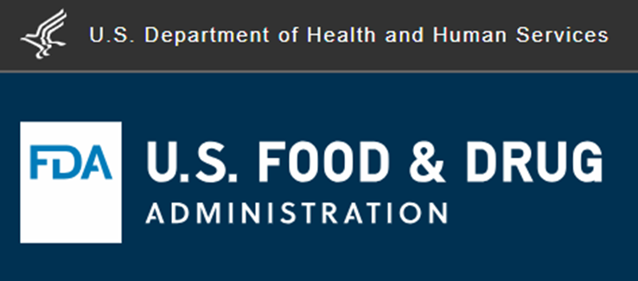
FDA Guidance on MOUD and Sedatives
MOUD should not be withheld from patients taking benzos or other CNS depressants
While taking both could have serious side effects, untreated OUD outweighs the risks
Careful medication management can reduce those risks
Notes:
2017 guidance https://www.fda.gov/Drugs/DrugSafety/ucm575307.htm

Slide 25
Alcohol
NIDA CTN study found 38% prevalence of AUD among people seeking OUD treatment
Other analyses found alcohol involvement in one fifth of opioid related deaths

Slide 26
Medications for Alcohol and Opioid Use Disorder
Naltrexone IM (Vivitrol) may be best choice, as it is FDA approved for both conditions
May require medically assisted withdrawal management (e.g., inpatient “detox”), as outpatient induction may not be appropriate

Slide 27
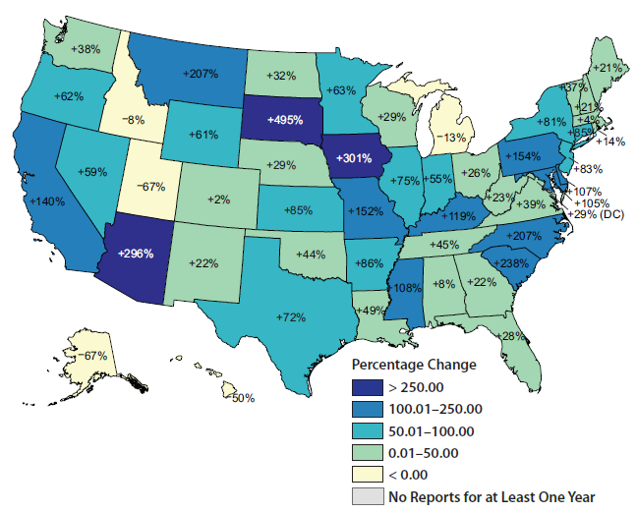
Fentanyl
Percentage change in fentanyl reports in NFLIS-Drug in the United States by State: 2016–2017

Slide 28
Best Practices to Treat MOUD and Other Opioid Use
Informed consent
Regular UDS
Checking CURES
Shorter supplies of buprenorphine
See patient more frequently

Slide 29
Summary
Nonopioid substance use is common in patients on MOUD
Practice should focus on treating the nonopioid substance use
MOUD treatment should be continued

Slide 30
More on Contingency Management (aka Motivational Incentives)
Best practice for stimulant use disorder in patients with MOUD
Use tangible rewards for concrete behaviors
Use escalating rewards (get more incentives with more positive behavior) or fishbowl method (pick tickets with reinforcers)

Slide 31
How Incentives Could Work For You
Give Incentive
Patient attends
treatment,
gives negative samples
More patients
attend treatment
give negative samples

Slide 32
Basic Behavioral Principles
1. Frequently monitor target behavior
2. Provide incentive when target behavior occurs
3. Remove incentive when target behavior does not occur

Slide 33
Contingency Management Models
Fish Bowl | Escalating Reinforcers
Increasing draws with increasing target behavior | Increasing rewards for increasing target behavior
One draw for first negative urine, two draws for 2nd | Gift card for every negative urine
Draws range from “good job” to “jumbo” prize | More consecutive negative tests, more rewards (bonuses)
Keeps costs down | More expensive

Slide 34
Fishbowl Ticket Ratios

Slide 35
CM Implementation Tips
Staff designated to coordinate
Give reinforcement frequently
Easy to earn initially (set the bar low)
Reinforcers should be items of use and value to patients
Reinforcement should be connected to specific, observable behavior
Minimize delay in reinforcement delivery; greater delay, weaker effect
Focus on small steps; any improvement
Simple is better

Slide 36
Questions?
Contact Gloria Miele, PhD, gmiele@mednet.ucla.edu

